Slide 1

Australian Government
Geoscience Australia
Responding to major external events — a framework for action
The GeoPLUS 2005 team
Preparing for simulation

Slide 2
Introduction
Welcome
Why are we here?
Process Summary
Process highlights
Demonstrate Template
Introduce next presenters
Interactions within Template
Questions can be asked at anytime

Slide 3
Why are we here?
Task
Develop an organisational template that will help GA respond flexibly to major external Events
Present the process used throughout this task
Review the process, identify lessons learnt and establish conclusions

Slide 4
Process Summary
22/7
GeoPLUS session at Archives
Task assigned to group
25/7
First full group meeting
Two sub-groups formed to look at internal (1) and external (2) factors
Organised a meeting with CEO to elicit how GA responded to Tsunami event
Ground rules and timeframes developed
1/8
Discussion about Boxing Day Tsunami event
Highlighted issues that the group needed to address with regard to the task
3/8 – 10/8
Sub-groups met separately several times
Developed a response template, a break down of factors i.e. communication, resources, drivers and inhibitors
Established and agreed on a conceptual plan/template. Agreed to the development of three teams in the plan.
19/8
Deliverance of sub-group findings meeting
Realised that internal and external factors were more linked than first considered.
Created the formation of two sub-groups to review prior results

Slide 5
Process Summary continued
24/8 – 31/8
Sub-group meetings
Revised template then circulated to second sub-group
Organised the concept of a check list. A detailed list of what the template/diagram says.
5/9
Whole group meeting – to review findings
Final draft reviewed by whole GeoPlus group
Presented template to whole group and discussed the next stage, presentation.
Allocated staff to presentations.
9/9
First meeting for presenters
Discussed presentation ground rules / templates
9/9
Whole Process meeting
Meet to discuss and converge all documents for the final processes used though out this scenario
16/9
Presenters Drafts
Went though each presentation and advised revision
26/9
Whole group presentation – Review
Presented a test run of whole presentation.

Slide 6
Process Highlights
Chair person’s were organised for all meetings
Minutes were made at each meeting and sent to all for comment
Members had the right to choose what aspect they wanted to be part of, no actual ‘delegation of roles to others’ was needed, people always volunteered
We always had the right to speak out, depending on your personality trait
The enthusiasm was there by all throughout whole process, yet wavered due to work commitments

Slide 7
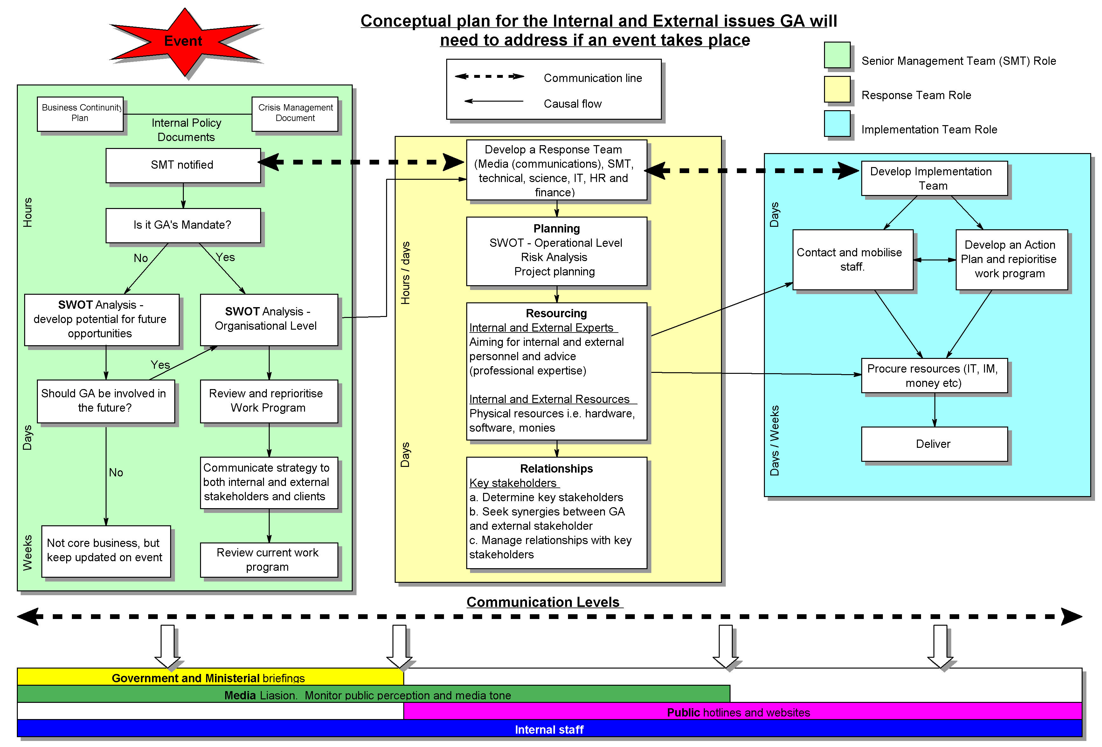

Slide 8
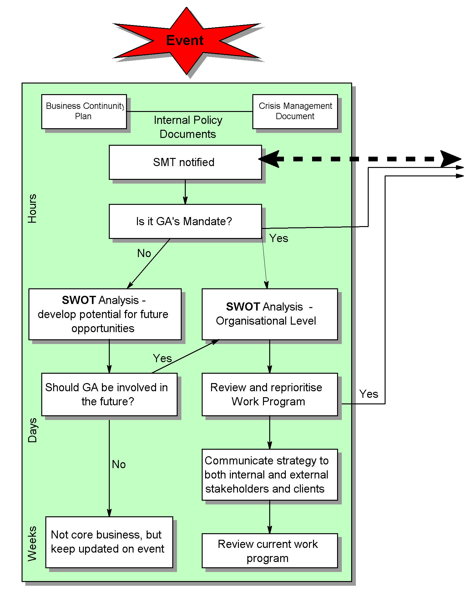
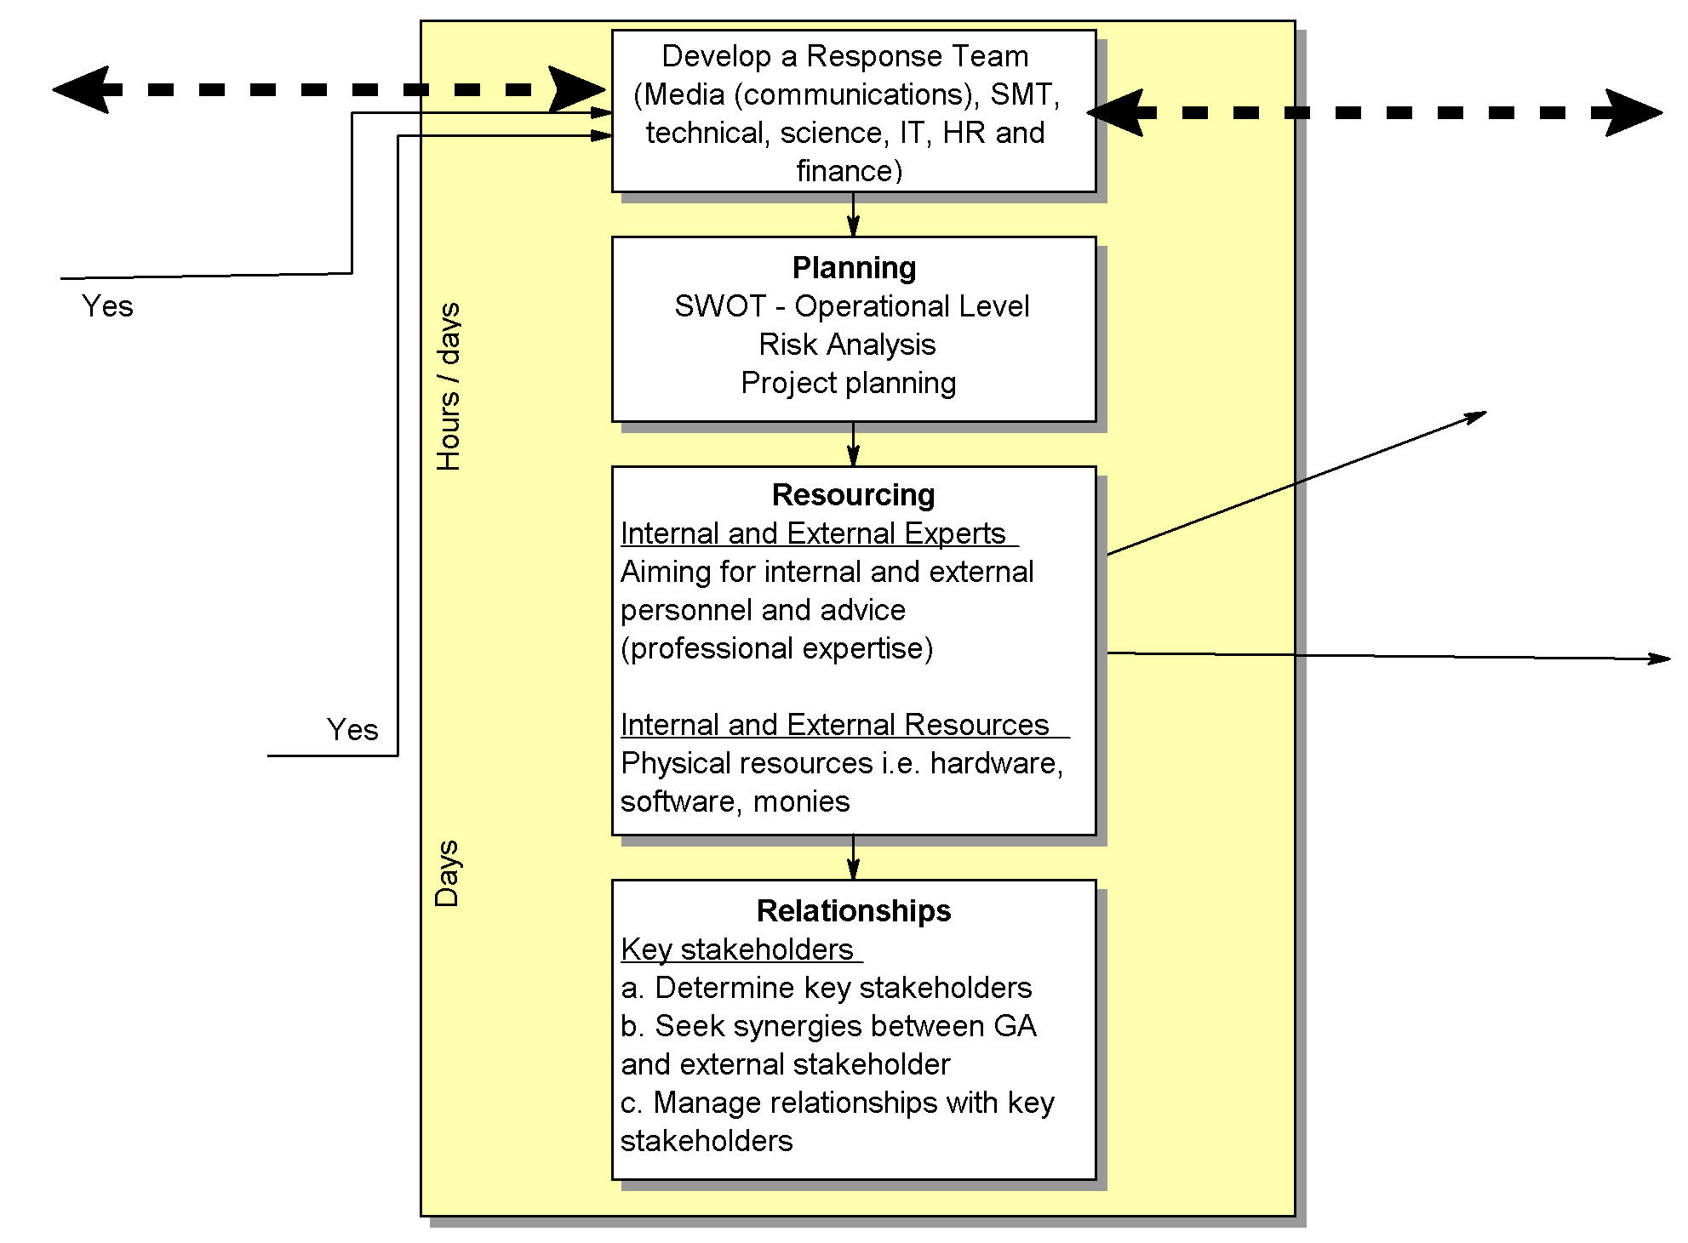
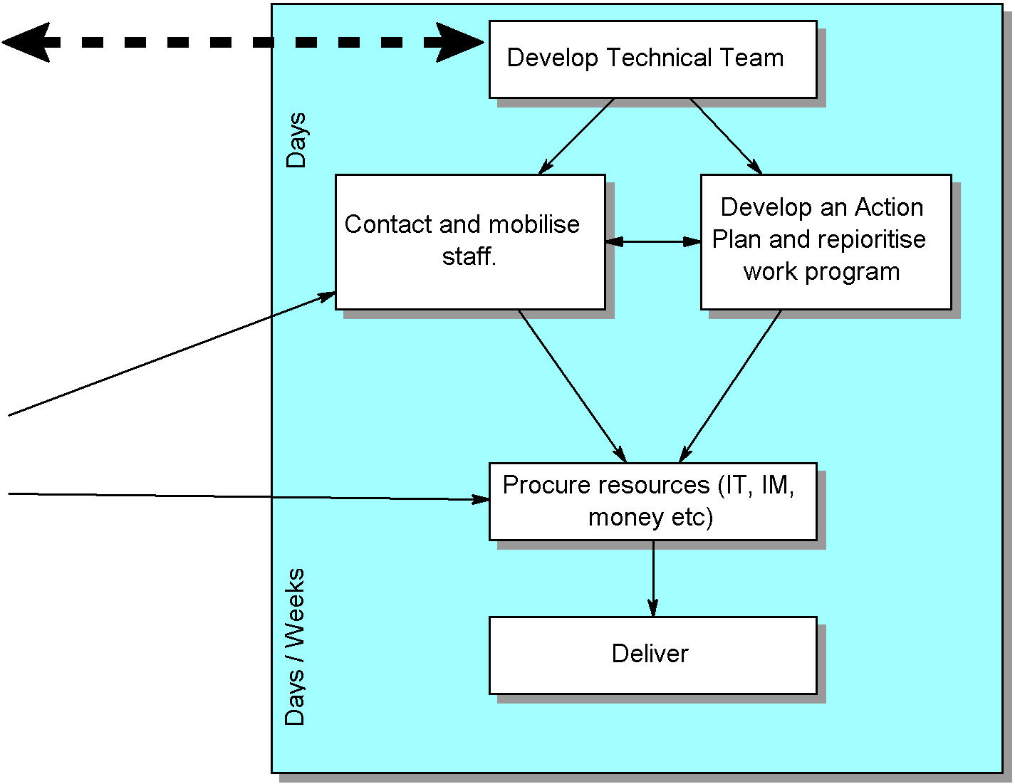
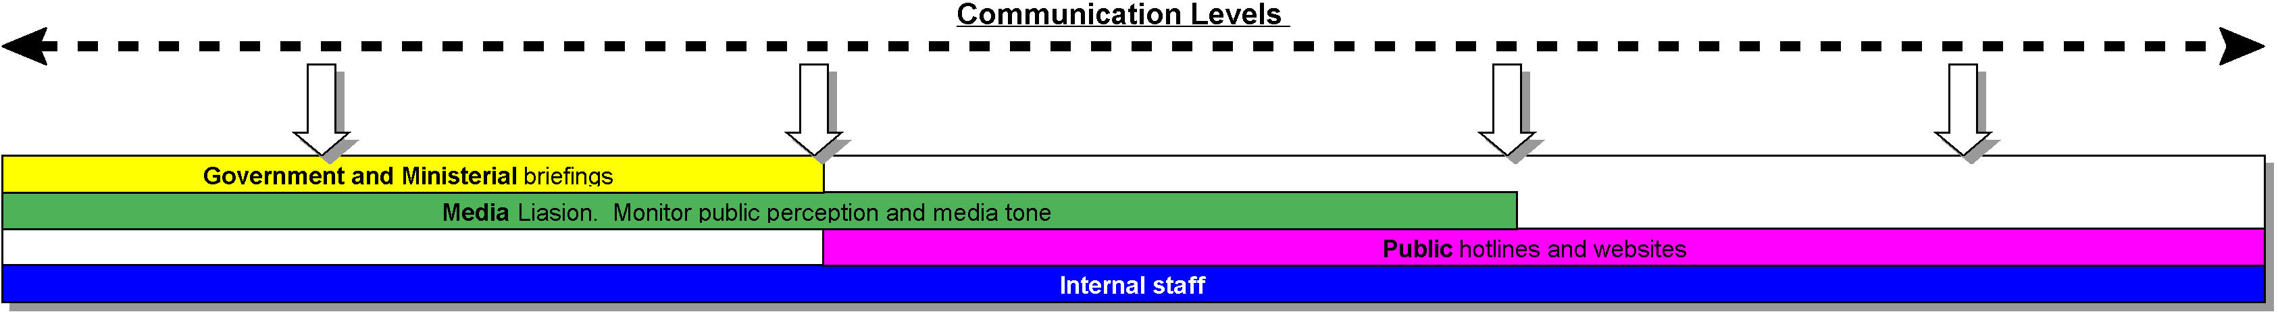
Introducing next Presenters
Senior Management Team
Ole Nielsen
Response Team
Phillip Tickle
Implementation Team
David Huston
Communications
Shanti Reddy
Conclusions and lessons learnt
Matt Hayne

Slide 9
Interaction between each Team
1. Roles and Responsibilities
Broad responsibilities for each group
2. Flow Process
Decision making process (work flow)
3. Interaction with other teams
Communication flow

Slide 10
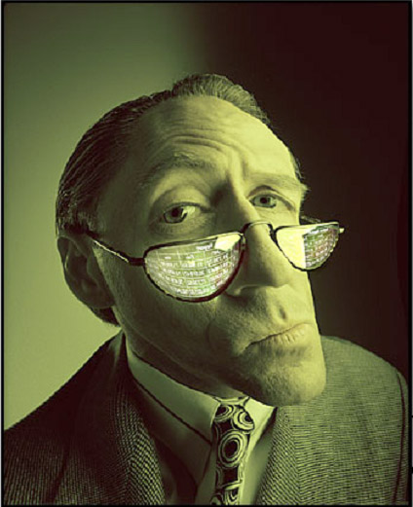
Senior Management Team

Slide 11
Roles and Responsibilities of SMT
Keep informed and alert (to events)
Scope potential involvement of GA
Identify risks to GA
Review work priorities
Identify key-stakeholders
Organise Ministerial Briefings
Organise Media Liaisons

Slide 12
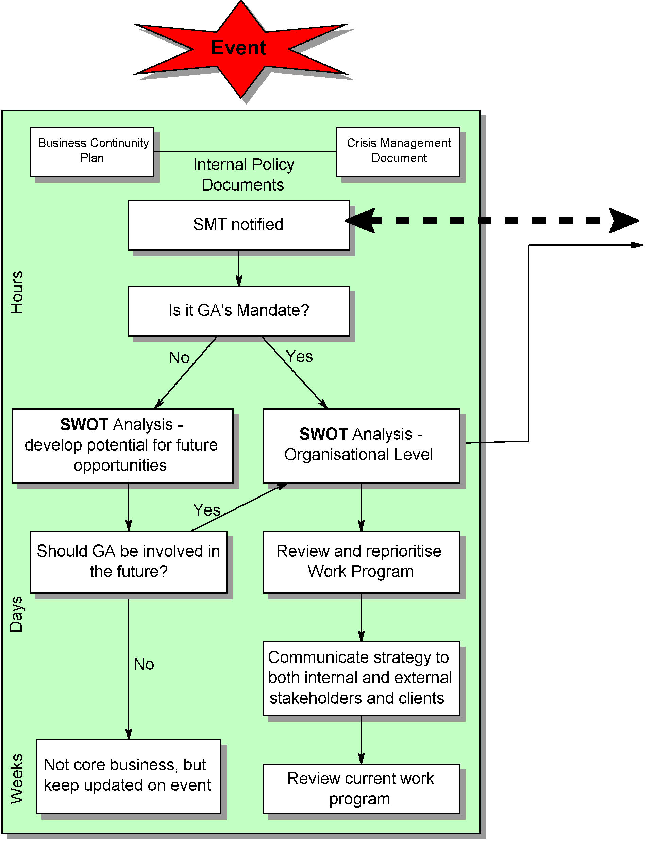

Slide 13

SWOT if event is not GA’s Mandate
  What are the Drivers (National Priorities)?
  Potential for extra funding?
  Can new strategic partnerships be formed?
  Will core business be adversely affected?
Obtain Mandate or
Keep updated

Slide 14
SWOT if event is GA’s Mandate
  Who will take the lead?
  Who are the other stakeholders?
  Do we have sufficient resources?
  Is GA vulnerable to blame?
Form Response Team

Slide 15
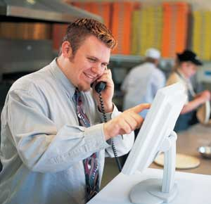
Response Team

Slide 16
Roles and Responsibilities of the Response Team
K
S
I
R
I
B

Slide 17
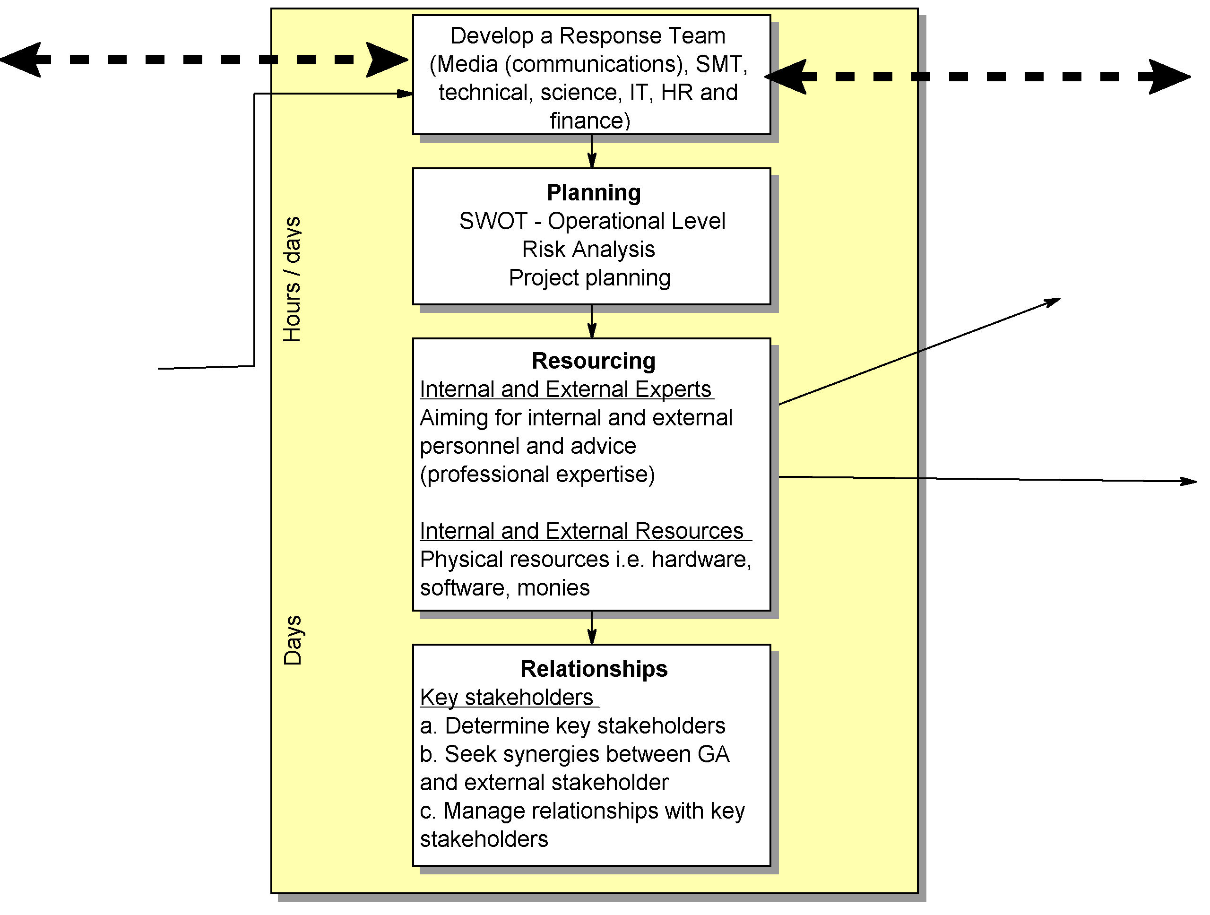

Slide 19
Interactions

Slide 20
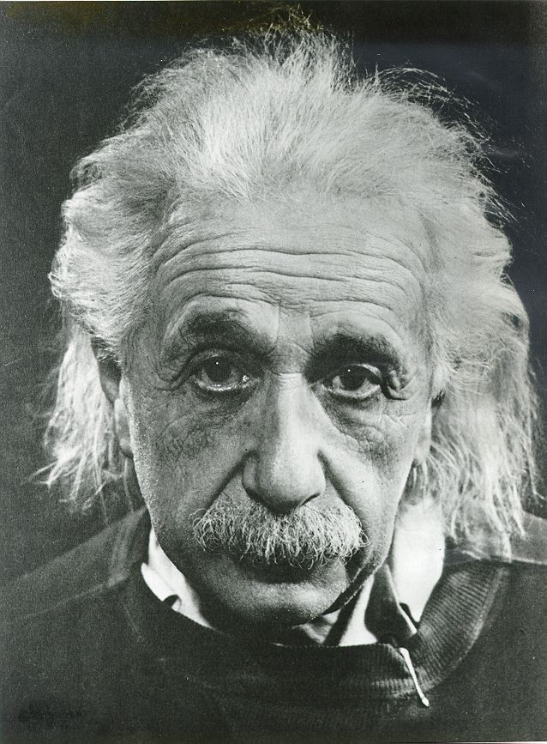
Implementation Team

Slide 21
Roles and Responsibilities of the Implementation Team
Determine technical team and processes to most effectively address event
Undertake planning based on scale and timeframe of event and perceived risk to GA
Re-prioritise other technical programs to free up resources
Maintain communication with other players at the scientific/technical level
Deliver outputs on time and on budget
Assure that outputs are of high quality and meet needs of clients
Communication

Slide 22
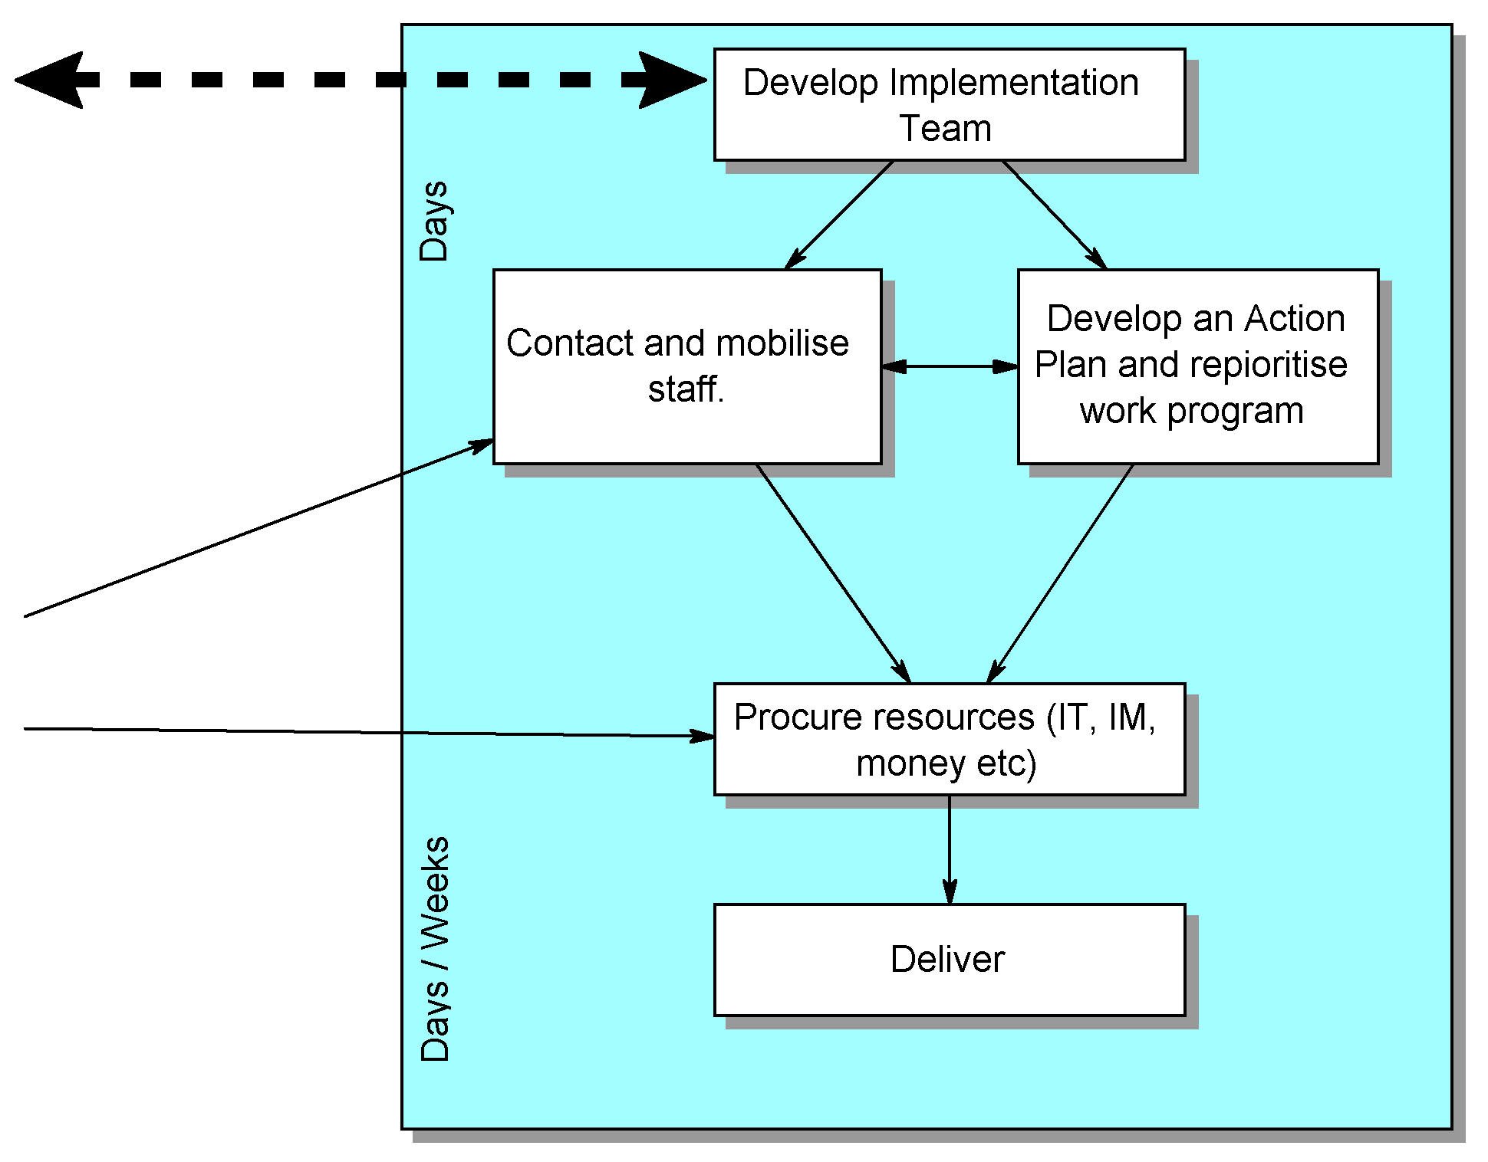

Slide 23
Potential problems
Contacting and mobilising key staff during an event requiring rapid response
Reprioritising work program (both officially and unofficially)
Output delivery
Closeting from rest of GA

Slide 24
Interactions
Interact directly with the Response Team
Interact indirectly with SMT through the Response Team
Interact directly with staff from other technical organisations
Interact with stakeholders on a technical basis

Slide 25
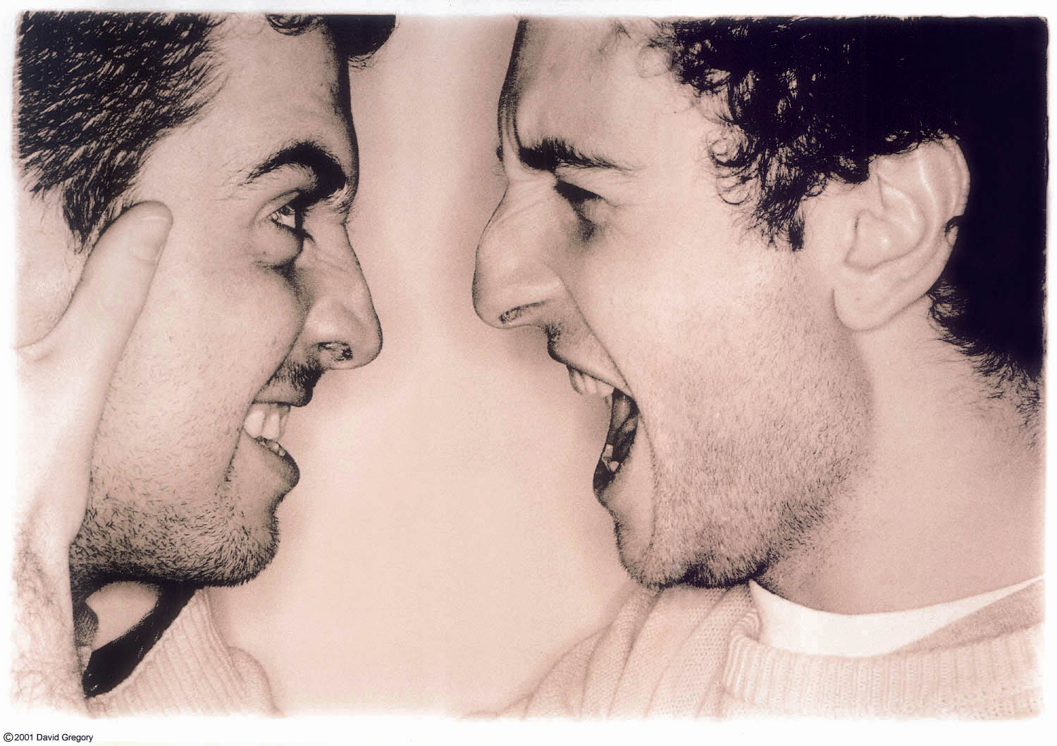
Communication Patterns

Slide 26
Communications Strategy
Roles and Responsibilities (1)
In case of catastrophic events – expect insatiable demand for information. Pressure is on for info from Media, Public and Minister (in that order)
GA has Media protocols, CEI, crisis and business continuity planning procedures. GA has ICE contact 24 hrs hotline
Message needs to be consistent & fast; Gut feelings and instincts are important to avoid baits/hooks
Communication can be in the form of press conference, telephone contact, media interview, informal briefing to the minister, etc

Slide 27
Communications Strategy
Roles and Responsibilities (2)
Communications Liaison officer to monitor media perception, tone and feed this back to SMT
Challenge is to keep the disaster/event in focus not the organisation or individuals
SMT would have their own sources to seek feedback
Monitoring media reports is extremely valuable tool to gather information
Provide necessary training to technical experts to handle media interviews.
Disagreement amongst scientists can be detrimental

Slide 28
Interaction through
Open Communications Channels
Communications between SMT, Response and Implementation Teams is a critical part of the template that we developed
This is captured in the template in two ways – dashed lines between the teams suggesting open/ongoing communications in all decision making and the three solid bars below highlight different purpose and levels of communications
Make best use of all available communication channels such as web site, telephone hotlines, media to disseminate information for public consumption

Slide 29
Observations on process
Group involvement
    Group members were away (sometimes > 50%)
    Retaining participation and ownership requires various strategies
Greater participation = more time & consultation
    Big groups focus on process rather than delivery
    Small subgroups on specific problems effective
Individual involvement
    Tendency to gravitate towards preferred role
    Members initially tentative about assuming roles & responsibilities

Slide 30
Observations on process
Common focus across group
    Democratic processes to define the overarching problem, roles, responsibilities and process
    Mutual respect
    Tolerance
Structured meetings and tasks (structure is paramount)
    Ground rules established
    Roles and responsibilities identified
    Minutes kept and TRIM used
    Inclusive formal and informal lines of communications developed and maintained

Slide 31
Observations on process
Coordinated tasks and deliverables
    Options/approaches identified and approaches agreed by group
What can we do better
Documentation of process
Don’t assume some tasks are simple
Time management

